Slide 1
A U-Net Based Approach for Removing Salt-and-Pepper Noise from Images using Noise Mask
NAME: ANURAN CHAKRABORTY
ROLL: 001610501020
BCSE-IV

Slide 2
AGENDA
Introduction
Salt-and-Pepper Noise
Related Work
Proposed Method
Results
Conclusion

Slide 3
INTRODUCTION
Image denoising is an important research area in the field of image processing.
Salt-and-pepper noise removal is still considered as an open research problem.
Objective of the proposed method is to eliminate the need for any hand-designed guidance filter to remove such noise.

Slide 4
SALT-AND-PEPPER NOISE
It is a non-additive noise.
For 8-bit images the salt acquires intensity value 255, and pepper acquires intensity value 0.
This noise can cause sharp and unanticipated disturbances in the image.
Main challenge is identify the noisy pixels as the original pixels may also have values 0 or 255.

Slide 5
RELATED WORK
Traditional approaches like Median Filter [1] and Adaptive Median Filter [2] may not always provide good results.
A deep learning approach using Stacked Sparse Denoising Autoencoders (SSDA) [3] was proposed but it was not robust to a high variation in noise.

Slide 6
PROPOSED METHOD
A deep learning based method has been proposed
It consists of 3 steps:
Creation of noise mask from noisy image
Denoising a noisy image using encoder-decoder and noise mask as input
Post-processing of the denoised image using noise mask
U-Net is used to perform both creation of the noise mask and denoising of the image.

Slide 7
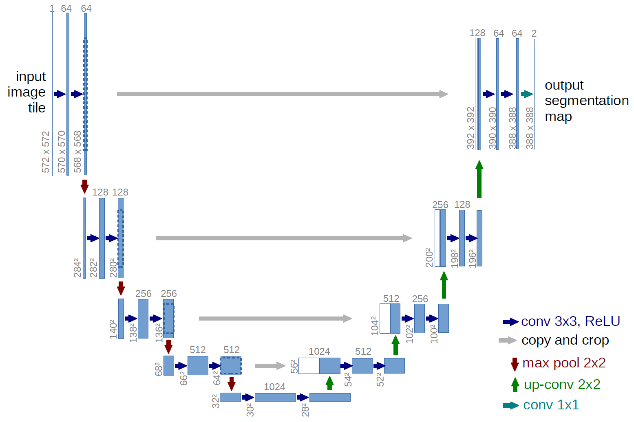
PROPOSED U-NET BASED ARCHITECTURE

Slide 8

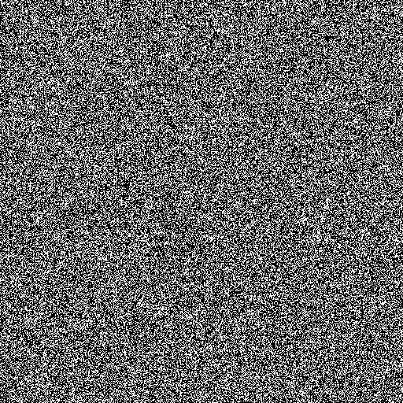
PROPOSED METHOD: GENERATION OF NOISE MASK
Noisy Image
Noise Mask
U-Net for Noise Mask
U-Net takes the Noisy Image as input and gives the Noise Mask as output

Slide 9
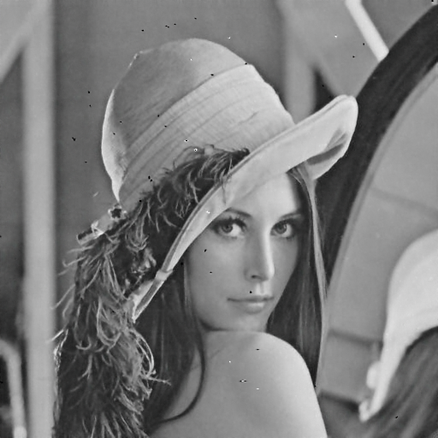
DENOISING OF NOISY IMAGE
Denoised Image
Noisy Image
U-Net for Denoising
Noise Mask
U-Net model for denosing the image takes the Noisy Image and the Noise Mask as input and gives the Denoised image as output

Slide 10

POST-PROCESSING
Final Denoised Image
Denoised Image
Post-processing
Noise Mask
Denoised image is further post-processed to get the final output

Slide 11
POST-PROCESSING
During the process of denoising by U-Net, some non-noisy pixels which should have remained unchanged may get affected.
From the Noise Mask obtained at stage 1, the non-noisy pixels are identified.
The location of non-noisy pixels in the denoised image is then replaced with the original values from the noisy image.

Slide 12
RESULTS
The method has trained and tested on the UCMerced Land Use dataset.
The method has also tested on some standard images like Lena, Baboon, and Boat.

Slide 13
PERFORMANCE COMPARISON
Method | 40% Noise |  | 60% Noise
 | PSNR | SSIM | PSNR | SSIM
MF [2] | 24.27 | 0.7925 | 21.57 | 0.7187
AMF [1] | 32.20 | 0.9280 | 21.60 | 0.6070
Deep CNN [4] | 39.83 | 0.9680 | 36.70 | 0.9443
Proposed Method | 38.41 | 0.9803 | 38.04 | 0.9733
Table 1: Provides a performance comparison of the proposed method with some state-of-the-art methods on the image Lena at 40% and 60% noise densities.

Slide 14
CONCLUSION
The U-Net based method has proved effective in salt-and-pepper noise removal, outperforming some past algorithms by a significant margin.
It also yields quite good results even for images with high-density noise.
In the future we can apply it to color images.

Slide 15
REFERENCES
[1] H. Hwang and R. A. Haddad, “Adaptive Median Filters: New Algorithms and Results,” IEEE Trans. Image Process., 1995, doi: 10.1109/83.370679.
[2] D. R. K. Brownrigg, “The Weighted Median Filter,” Commun. ACM, 1984, doi: 10.1145/358198.358222.
[3] J. Xie, L. Xu, and E. Chen, “Image denoising and inpainting with deep neural networks,” in Advances in Neural Information Processing Systems, 2012.
[4] Y. Xing, J. Xu, J. Tan, D. Li, and W. Zha, “Deep CNN for removal of salt and pepper noise,” IET Image Process., 2019, doi: 10.1049/iet-ipr.2018.6004.

Slide 16
THANK YOU

